Slide 1

Data Types
Every value in Java is either:
a reference to an object
one of the eight primitive types
Java has eight primitive types:
four integer types
two floating-point types
two other

Slide 2
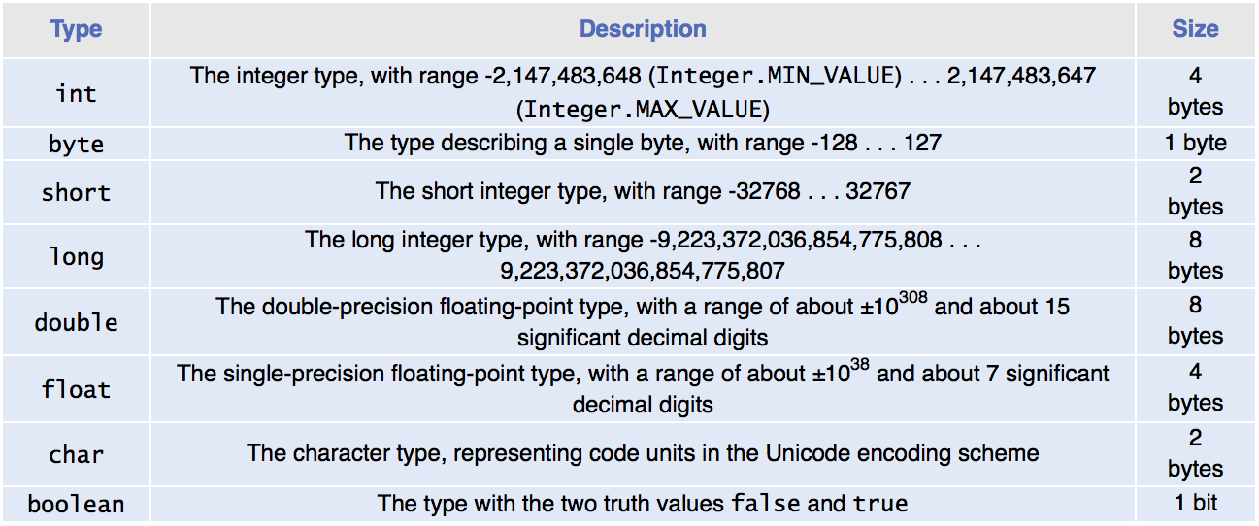
Primitive Types

Slide 3

Overflow
Generally use an int for integers
Overflow occurs when
The result of a computation exceeds the range for the number type
Example
int n = 1000000;
System.out.println(n * n); // Prints –727379968, which is clearly wrong
10¹² is larger that the largest int
The result is truncated to fit in an int
No warning is given
Solution: use long instead
Generally do not have overflow with the double data type

Slide 4

Rounding Errors
Rounding errors occur when an exact representation of a floating-point number is not possible.
Floating-point numbers have limited precision. Not every value can be represented precisely, and roundoff errors can occur.
Example:
double f = 4.35;
System.out.println(100 * f); // Prints 434.99999999999994
Use double type in most cases

Slide 5
Constants: final
A final variable is a constant
Once its value has been set, it cannot be changed
Named constants make programs easier to read and maintain.
Convention: use all-uppercase names for constants:
final double QUARTER_VALUE = 0.25;
final double DIME_VALUE = 0.1;
final double NICKEL_VALUE = 0.05;
final double PENNY_VALUE = 0.01;
payment = dollars + quarters * QUARTER_VALUE +
dimes * DIME_VALUE + nickels * NICKEL_VALUE +
pennies * PENNY_VALUE;

Slide 6
Constants: static final
If constant values are needed in several methods,
Declare them together with the instance variables of a class
Tag them as static and final
The static reserved word means that the constant belongs to the class
Give static final constants public access to enable other classes to use them.

Slide 7
Constants: static final
Declaration of constants in the Math class
public class Math
{
. . .
public static final double E = 2.7182818284590452354;
public static final double PI = 3.14159265358979323846;
}
Using a constant
double circumference = Math.PI * diameter;

Slide 8
Self Check 4.3
Which of the following initializations are incorrect, and why?
int dollars = 100.0;
double balance = 100;
Answer: The first initialization is incorrect. The right hand side is a value of type double, and it is not legal to initialize an int variable with a double value. The second initialization is correct — an int value can always be converted to a double.

Slide 9
Self Check 4.5
What is wrong with the following statement sequence? double diameter = 10.2;
double circumference = 3.14 * diameter;
Answer: Two things
You should use a named constant, not the “magic number” 3.14
3.14 is not an accurate representation of π. Use Math.PI

